Slide 1
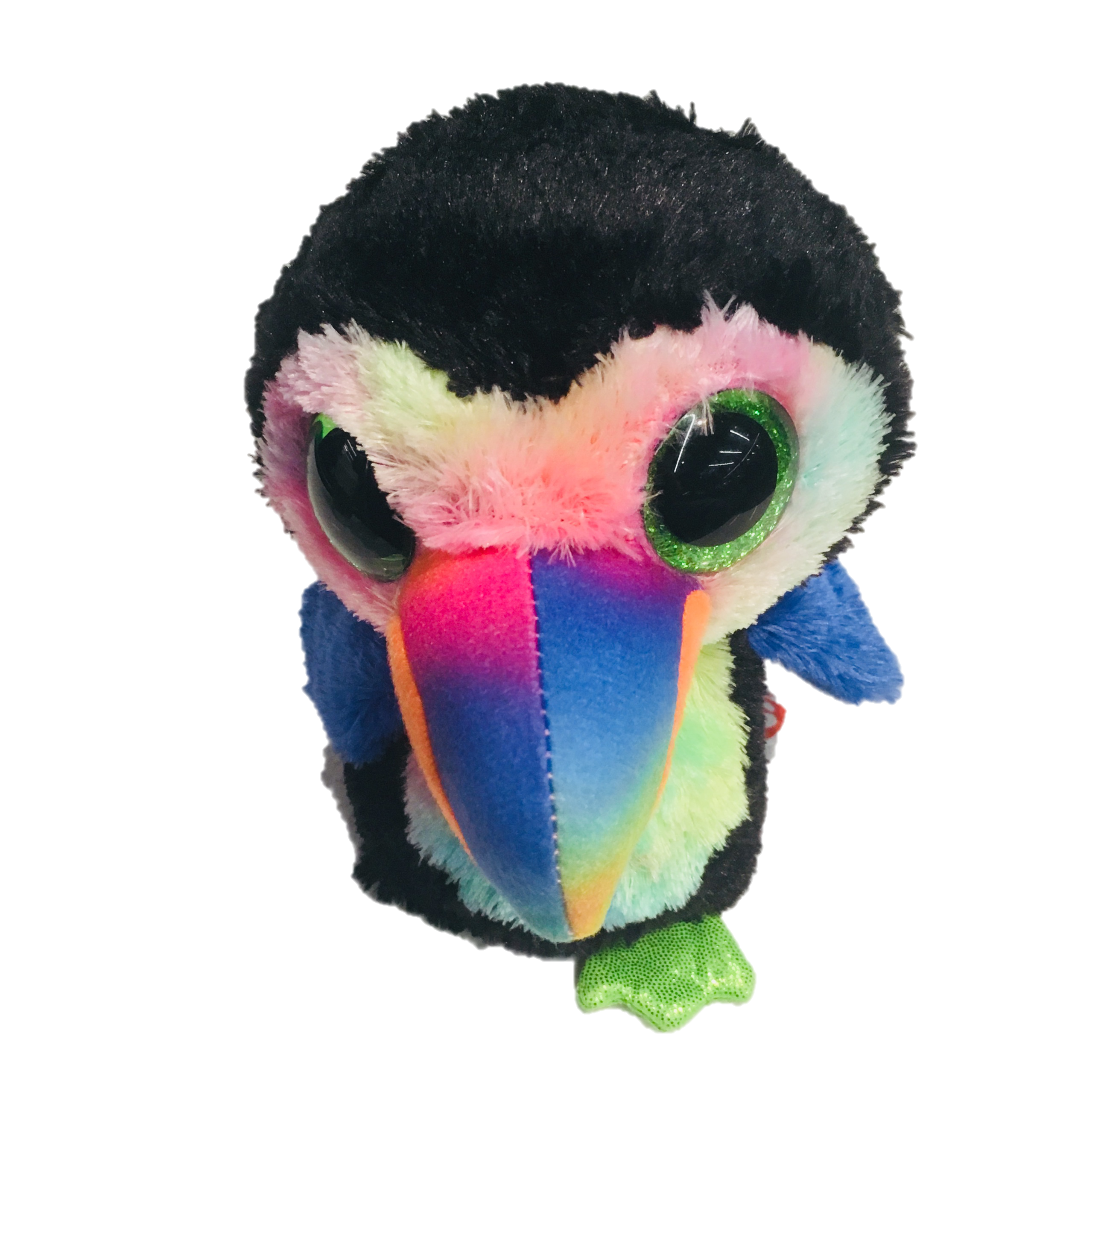
oTree workshop
Philipp Chapkovski
European University Institute
University of St.Gallen
May 22-25, 2018
Day 1

Slide 2
oTree
platform to run interactive online experiments
written on Python
open source
based on Django framework
responsive – can be run in mobile browsers, tablets etc.
Materials and code for this workshop: | https://chapkovski.github.io/teaching/
My e-mail: | chapkovski@gmail.com
oTree support group: | https://groups.google.com/forum/#!forum/otree
oTree documentation: | http://otree.readthedocs.org/

Slide 3
oTree
link to follow:
http://bit.ly/otree-workshop

Slide 4
Group projects
Work in pairs
The last session of each day (May 22, 23, 24) is for group work
Final session of May 25: presentation of the project

Slide 5
What kind of ‘basic’ behavioral games are widely used?
List as many behavioral games as you can
Give one-sentence description

Slide 6
What kind of ‘basic’ behavioral games are widely used?
Dictator Game
Trust (Investment) game
Prisoner’s Dilemma
Public good game (PGG)
PGG with punishment (Fehr and Gächter)
Beauty contest (Guess 2/3)
Real effort tasks
Principal-agent dilemma

Slide 7
Main building blocks of a game
Discuss in groups for 5 minutes
List blocks and the logic that links them

Slide 8
Main building blocks of any game
Data input/collection
Data processing:
calculation of payoffs and other properties based on input
Interaction of data across players (not in all games)
More data collection
Showing the results and other info
(Repeat – for multi-round games)

Slide 9
What do we need from experimental software?

Slide 10
virtualenv
Mac/Linux | Windows
Installing
python3 -m pip install --user virtualenv | py -m pip install --user virtualenv
Creating
python3 -m virtualenv env | py -m virtualenv env
Activating
source env/bin/activate | .\env\Scripts\activate
Leaving the virtual environment
deactivate

Slide 11
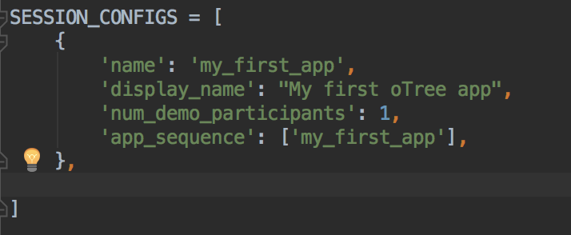
Let’s create our first oTree app
Create virtualenv
INSTALL OTREE: pip install –U otree
Check version: otree --version
otree startproject my_first_project
otree startapp my_first_app
add app to settings
otree devserver 80
go to: http://127.0.0.1

Slide 12

Very brief introduction

Slide 13
Structure of oTree app
Pages
Page classes
page_sequence
Models
Constants
Player, Group, Subsession
App definition in settings.py
Displaying logic
Data processing

Slide 14
Data processing: first intro
Models: where the data is stored (Player, Group, Subsession models)
Field types
doc, verbose_name, max_min, choices and other field properties

Slide 15
Anatomy of an oTree Page
Page creation:
class definition
template
When/if/for whom it is shown:
position in page_sequence
is_displayed method
What is shown:
vars_for_template method
What to do next:
before_next_page method

Slide 16
Methods of an oTree Page
BEFORE page is shown:
is_displayed (should return True if page is to be shown)
vars_for_template
AFTER page is shown:
before_next_page

Slide 17
Typical blueprint of a game
How many players?
Do they interact in the real time?
How many rounds?
Do players have different roles?
What are the main stages within each round?
When and how payoffs are calculated?
What kind of information a player needs from other players?
What kind of external (preexisting) information is needed?
How treatments change the game flow?

Slide 18
GIT
Git init
git add .
git commit –m ‘Commit message’
git add remote origin <LINK_TO_GIT>
git push origin master
rolling back: git checkout <COMMIT_ID> .
git stash
git pull origin master
More info: http://rogerdudler.github.io/git-guide/

Slide 19
Heroku
create git first!
heroku create <APP_NAME>
heroku addons:create heroku-redis
git push heroku master
heroku run otree resetdb
heroku config

Slide 20
Our workflow
Compile the blueprint
Write the code
Test it locally
Push to git repo
Push it to heroku
Share it with me (chapkovski@gmail.com)

Slide 21
Guess game: description
A player has an endowment.
Random number is generated within certain limits
A player has to guess. The closer is the guess to a real number the larger is the profit.
Two fields: what is guessed, and a player’s decision
Three screens:
Intro: instructions
Decision with instructions
Results

Slide 22
Guess game - blueprint

Slide 23
Guess game - blueprint
1 player
No interaction
1 round (or more)
No roles
Generating random number, letting player to guess, show them results
After the guess is made
No info is needed from others
Pre-generated random number
No treatments

Slide 24
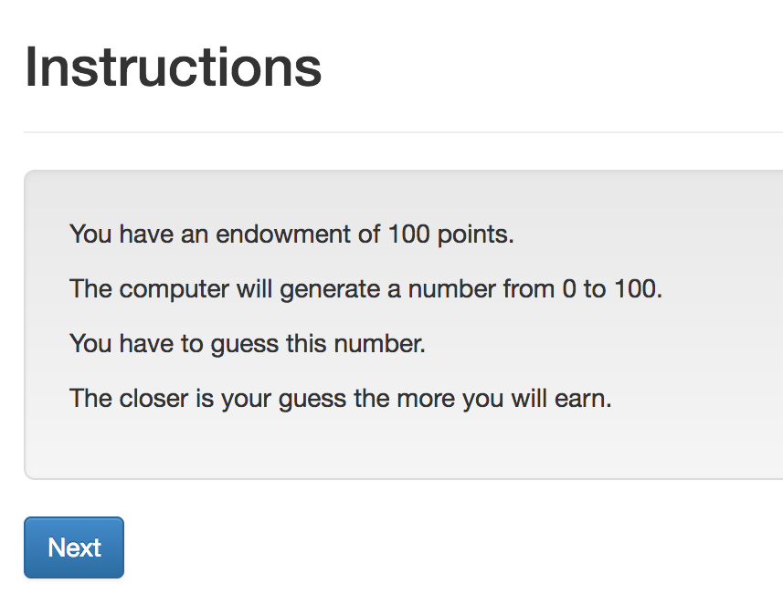
Guess game: screen 1

Slide 25
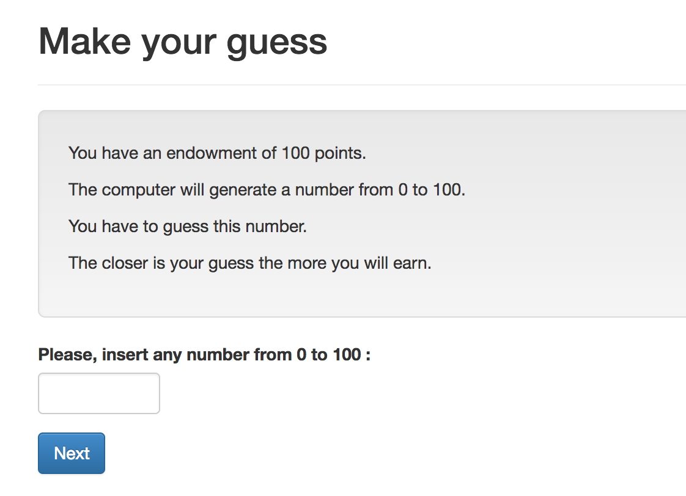
Guess game: screen 2

Slide 26
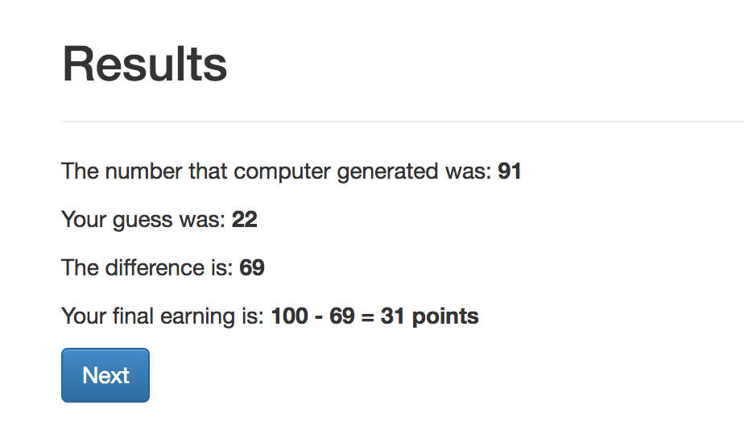
Guess game: screen 3

Slide 27
Guess game - Models
Creating new fields:
Field_Name = models.IntegerField()
Options:
Field_Name = models.IntegerField(
max=…,
min=…,
verbose_name=…,)

Slide 28
Guess game: Models. Result:
class Player(BasePlayer):
toguess = models.IntegerField(min=Constants.minguess,
max=Constants.maxguess,
doc='random number for a player to guess')
guess = models.IntegerField(min=Constants.minguess,
max=Constants.maxguess,
verbose_name="Please, insert \
any number from {} to \
{}".format(Constants.minguess,
Constants.maxguess,),
doc='guess of the player')

Slide 29
Guess game: Views
Creating new page
Class NameOfThePage(Page):
pass
Page_sequence
Page_sequence = [NameOfThePage]
By default name of the template should correspond to the page name!

Slide 30
Guess game: Views. Built-in functions
Built-in functions of pages:
”Normal” page:
def is_displayed(self):
return (True/False)
def vars_for_template(self):
return {‘var’: var}
def before_next_page(self):
…

Slide 31
Guess game - Templates
{% extends "global/Page.html" %}
{% load static otree %}
{% block title %} YOUR TITLE HERE {% endblock %}
{% block content %}
YOUR CONTENT HERE
{% endblock %}

Slide 32
Templates: using variables
In a template you can access variables defined in vars_for_template of the specific page:
{{ var }}
You can also use lists and dictionaries
You can also access any variable in Constants, Player, Group…
{{ player.payoff }}

Slide 33
Guess game - Templates
to include another file (for example instructions):
{% include ‘path_to_file/name_of_file.html %}
to make ‘Next button’:
{% next_button %}

Slide 34
Guess game: Views. Intro

Slide 35
Intro: How to do it?
Models.py: Constants:
endowment
minguess
maxguess
Intro.html:
in {% block content %}:
to refer to the constant: {{ Constants.endowment }}
Case sensitive!
No calculations! It is not Python!

Slide 36
Intro: Results:
{% extends "global/Page.html" %}
{% load staticfiles otree_tags %}
{% block title %}Instructions{% endblock %}
{% block content %}
{% include 'guess/instructions.html' %}
{% next_button %}
{% endblock %}
WHY?

Slide 37
Views.Decision

Slide 38
Views.Decision. How to do it?
Referring to models. field in views.py:
class Decision(Page):
form_model = ‘player’
form_fields = ['guess']
referring to a field in a template:
{% formfield player.guess %} OR {{form}}
Generating random number:
class Intro(Page):
def before_next_page(self):
toguess = random.randint(Constants.minguess, Constants.maxguess)
self.player.toguess = toguess

Slide 39
Views.Resuts

Slide 40
Views.Resuts. How to do it?
in views.py: Decision page:
class Decision(Page):
...
def before_next_page(self):
self.player.set_payoff()
in models.py :
class Player(BasePlayer):
…
def set_payoff(self):
self.diff = abs(self.guess - self.toguess)
self.payoff = Constants.endowment - self.diff

Slide 41
Running the app
otree devserver
go to: http://127.0.0.1:8000

Slide 42
Guess game
Write the code
Push it to git
Deploy it to heroku

Slide 43
Extra task: multi-round
make the game multi-round
Final results: an accumulated over n rounds

